Slide 1
SCB Network Access
Pre-requisites
Remedy ID/password
SCB Proxy ID/password
Laptop included in Whitelist for SCB
DLP installed in laptop
Verify the Pulse secure version is 9.1.11,Any Pulse Secure client below 9.1.11, required to update to certified version 9.1.11. Please download ps-pulse-win-fips-9.1r11.5-b9453-64bitinstaller.zip and install

Slide 2
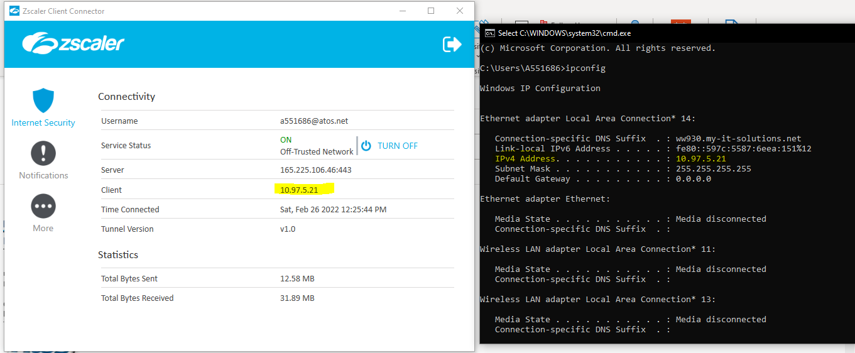
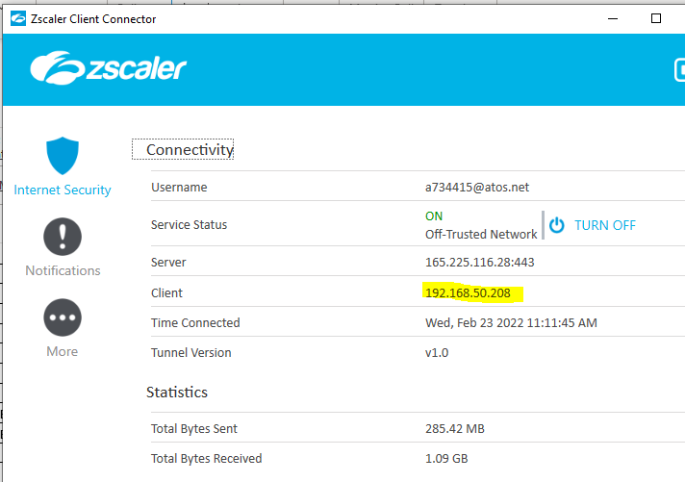
SCB Network Access
Zscaler Pre-requisites
Validate Zscaler is showing your local IP in client, before starting the URA
After URA established, Zscaler updated in VPN Trusted network with client IP address updated. Test the remedy access and confirm the status

Slide 3
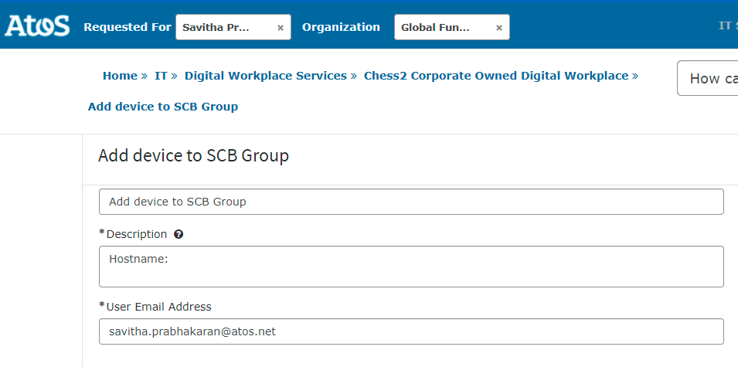
Setup / Request process for SCB Network pre-requisites-
Whitelist
Peoplewise ID/password & SCB Proxy ID/password
Request to PMO (dl-hk-scbttpmo@atos.net)
For Zeus program, request to Zeus PMO (atos_zeus_program_management@atos.net)
Request for Laptop to be included in Whitelist for SCB
Get email approval from your line manager
Raise request through https://pisa.myatos.net/home?id=sc_cat_item&sys_id=3e08eafedb4a491087140149f4961972

Slide 4
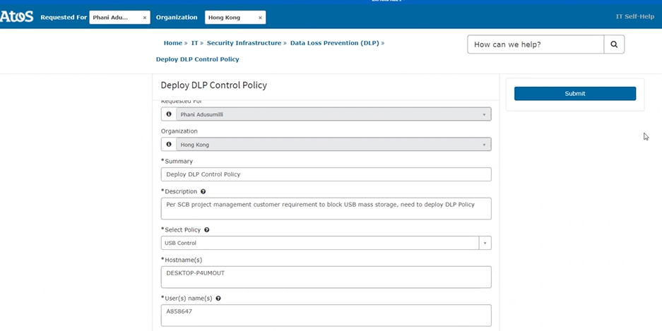
Setup / Request process for SCB Network pre-requisites-
DLP
Request for Laptop to be included in DLP
Get email approval from line manager
Raise request through https://pisa.myatos.net/home?id=sc_cat_item&sys_id=3e08eafedb4a491087140149f4961972

Slide 5
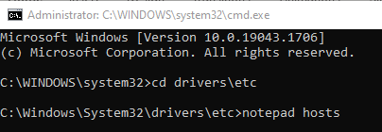
Steps to configure laptop to access SCB Network
1. Update Hosts File
Open Command Prompt with administrator privilege.
Open notepad and edit the hosts file under c:\Windows\System32\drivers\etc directory.
Add hosts file with following entries
# CIAO Server
172.16.222.178 HKHKI001
#New Balabit Host Information
#10.21.133.180 sam.sg.standardchartered.com
#10.21.133.184 sam.hk.standardchartered.com
#
10.21.205.213 samao02a.hk.standardchartered.com samaom.hk.standardchartered.com
10.21.205.215 samao02b.hk.standardchartered.com samaoj.hk.standardchartered.com
10.21.205.217 samao03a.hk.standardchartered.com samao.hk.standardchartered.com
10.21.205.219 samao03b.hk.standardchartered.com
10.21.200.189 samao04a.hk.standardchartered.com
10.21.200.209 samao04b.hk.standardchartered.com

Slide 6
Steps to configure laptop to access SCB Network
2. Install Cert
3 new certs (2022) to be installed in sequence
Unzip the certificates found in certs.zip
Follow the steps found in Cert Install.pdf to install the certificates

Slide 7
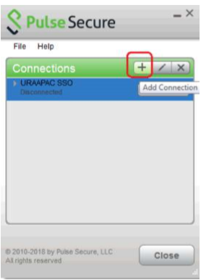
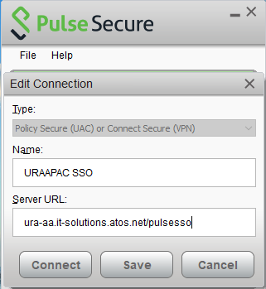
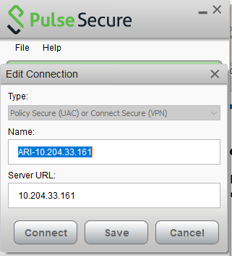
Steps to configure laptop to access SCB Network
3. Steps to configure laptop to access Pulse Secure
Click “add connection” from the Pulse Secure menu
Key in a Name such as Atos URAAPAC SSO and Server URL: ura-aa.it-solutions.atos.net/pulsesso
Key in a Name such as ARI-IP address and Server URL:
10.204.33.161
10.204.33.162
10.204.65.161
10.204.65.162

Slide 8
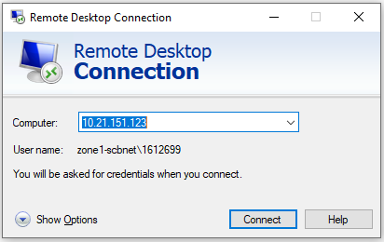
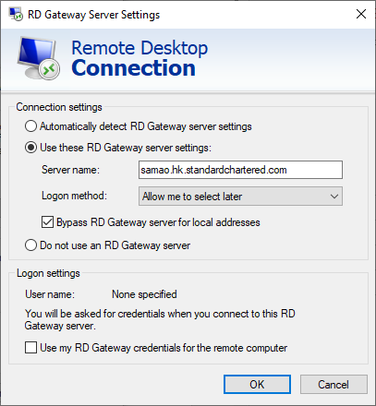
Steps to configure laptop to access SCB Network
4. RDP Setting
Connect to either of the servers 10.21.150.40
10.21.150.41
10.21.150.42
10.21.150.43
10.21.151.122
10.21.151.123
10.21.151.124
10.21.151.125
Click Show Options & select Advanced Tab, then click settings.
Enter either of the server names as RD Gateway
samao02a.hk.standardchartered.com
samao03a.hk.standardchartered.com
samao04a.hk.standardchartered.com
On DR drill or DR run, please use one of the following:
samao02b.hk.standardchartered.com
samao03b.hk.standardchartered.com
samao04b.hk.standardchartered.com

Slide 9
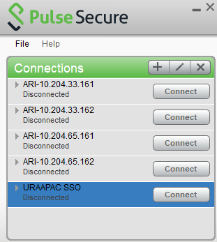
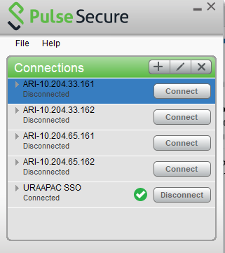
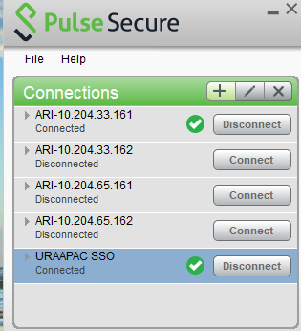
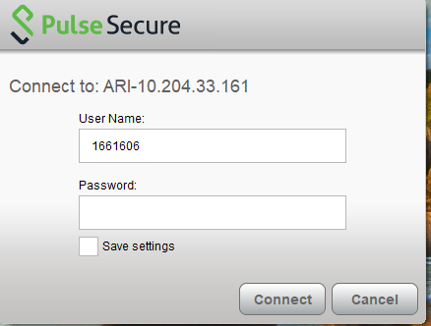
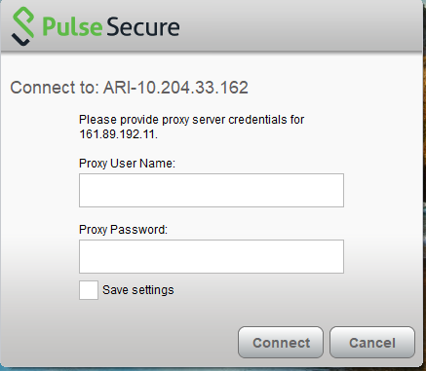
Connect to Atos URA & ARI
Open Pulse Secure and connect to Atos URAAPAC SSO
Connect to Remedy using Google Chrome https://161.89.192.41:8443/arsys/shared/login.jsp?/arsys , Enter Bank ID & Password.
If you have issues logging into Remedy, send email to PMO to reset password.
If you can access Remedy, Connect to ARI
When prompted for Proxy Username, enter your HONGKONG\DAS ID & Password
Next you will be prompted for Username, enter your Bank ID & Password

Slide 10
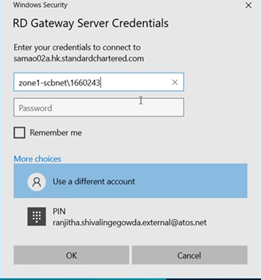
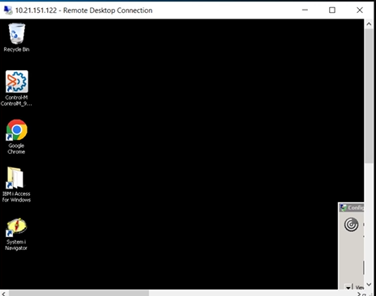
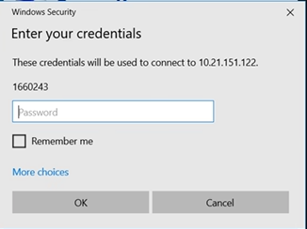
Connect to RDP
Open Remote Desktop Connection & click connect
You be prompted for login to RD Gateway
Enter zone1-scbnet\Bank ID & Password to connect
Next you will be prompted for login to remote desktop
Enter your Remedy password
You will reach SCB network remote desktop

Slide 11
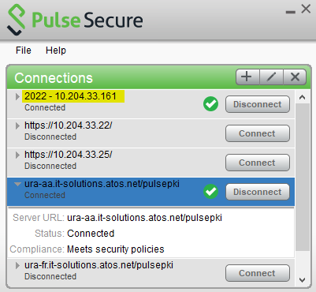
FAQ
Problem with any connectivity issue (Sharedrives / slowness / Zscaler status in Off-trusted, etc.
Check the version of Pulse secure, if it is the old version, please update with the latest version from the company portal

Slide 12
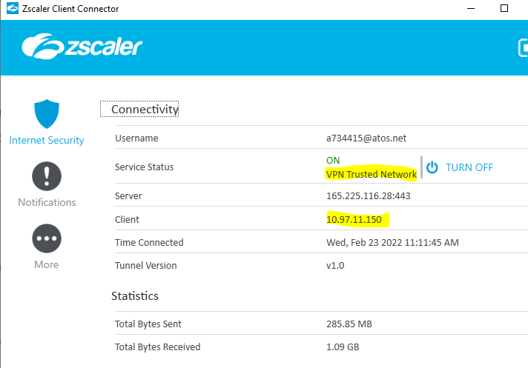
FAQ
2. After connect to new ARI, remedy in ASN 161.89.192.41 / 161.89.194.41 are not connectable
Reboot the laptop before re-establish connections
Validate Zscaler is showing your local IP in client, before starting the URA.
After URA established, Zscaler updated in VPN Trusted network with client IP address updated. Test the remedy access and confirm the status.
Establish the ARI to bank network, and re-test with remedy access.
Perform ping test and nslookup check screen capture in case issue persists.
ping 161.89.192.1 -t
ping 161.89.194.1 -t
nslookup

Slide 13

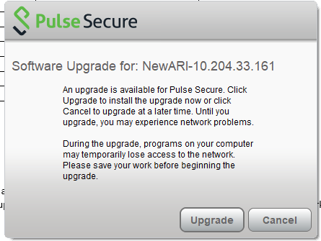
FAQ
3. Intermittent timeout experienced to connect terminal servers regardless ARI, in some attempts, try to re-connect and connect ARI will have different connectivity behaviour.
New ARI and old ARI is leveraging the same link connecting to SCB via proxy. Case has been filed to network support to check for link level utilization between proxy toward SCB network.
May be a possible workaround, even the VPN client might be showing connected, it might need some time for handshake. Wait until the software upgrade prompt came out, by that time the tunnel is stabilised

Slide 14
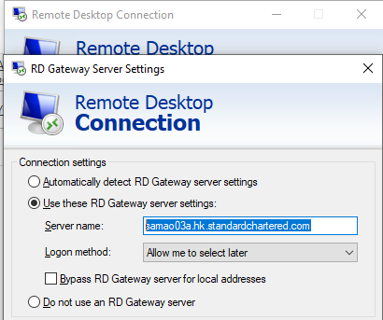
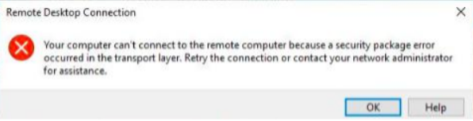
FAQ
4. Please validate the SAM gateway settings and confirm if you are using the latest server list.
10.21.205.213 samao02a.hk.standardchartered.com samaom.hk.standardchartered.com
10.21.205.215 samao02b.hk.standardchartered.com samaoj.hk.standardchartered.com
10.21.205.217 samao03a.hk.standardchartered.com samao.hk.standardchartered.com
10.21.205.219 samao03b.hk.standardchartered.com
10.21.200.189 samao04a.hk.standardchartered.com
10.21.200.209 samao04b.hk.standardchartered.com
5. Whenever users encounter following errors, please adjust the Balabit SAM gateway settings to any servers mentioned above. Also validate the laptop host table to make sure the IP being pointed to.
In addition, if the error persists, please perform the following adjustment as a known issue to the vendor.

Slide 15
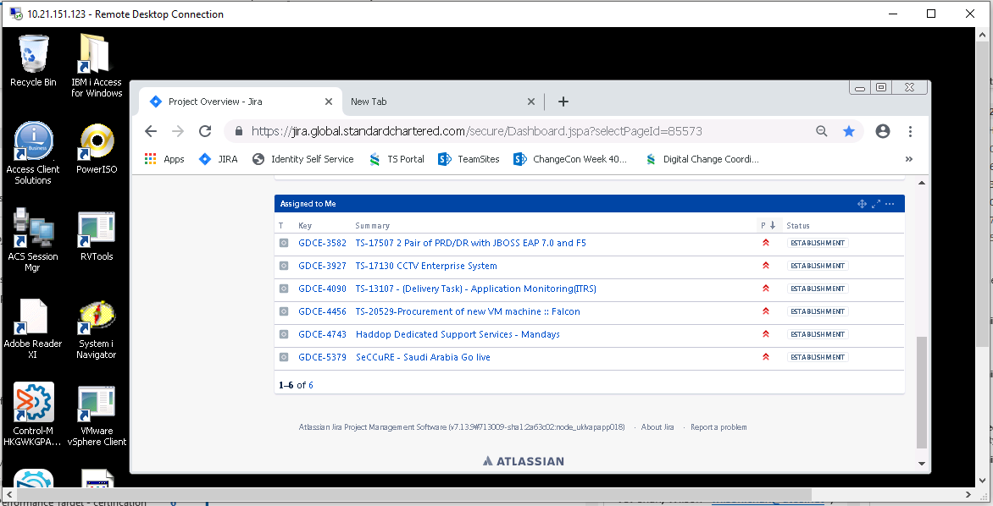
Connect to JIRA
Go to https://jira.global.standardchartered.com

Slide 16
Useful links in SCB Network
Website | URL
Remedy (Access from Atos Network) | https://161.89.192.41:8443/arsys/shared/login.jsp?/arsys https://161.89.194.41:8443/arsys/shared/login.jsp?/arsys
Remedy (Inside SCB Network) | https://oneit.global.standardchartered.com:8080/arsys/shared/login.jsp
JIRA | https://jira.global.standardchartered.com
TS Portal | https://ts.global.standardchartered.com/tsportal/new_deco_request/PSD********/
Digital Change Coordinator | https://ts.standardchartered.com/tsp/digital-change-coordinator
One Identity | https://oigprd.hk.standardchartered.com/identity

